Slide 1
Stellar Ages, Abundance Gradients, and Density Profile of the Large Magellanic Cloud
Josh Povick
APOGEE Winter 2020 Meeting

Slide 2
Outline
Star-by-Star Ages of the LMC
Polynomial Age Interpolation
Results
LMC Abundance Gradients
Motivation
Gradient Calculation
Results
Density Profile of the LMC
Motivation
APOGEE Field Mass Calculation
APOGEE Field Area Calculation
Results
Overall Results Recap

Slide 3
Outline
Star-by-Star Ages of the LMC
Polynomial Age Interpolation
Results
LMC Abundance Gradients
Motivation
Gradient Calculation
Results
Density Profile of the LMC
Motivation
APOGEE Field Mass Calculation
APOGEE Field Area Calculation
Results
Overall Results Recap

Slide 4
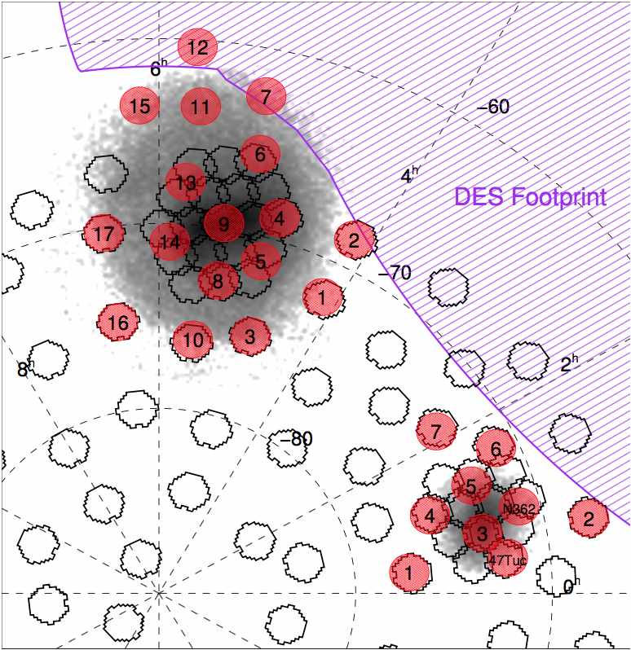
Polynomial Age Interpolation
The Magellanic Clouds are close enough to resolve individual sources and thus calculate individual stellar ages
Image Credit: Nidever et al. 2020

Slide 5
Polynomial Age Interpolation
The Magellanic Clouds are close enough to resolve individual sources and thus calculate individual stellar ages
Large sample of RGB stars selected based on location in CMD

Slide 6
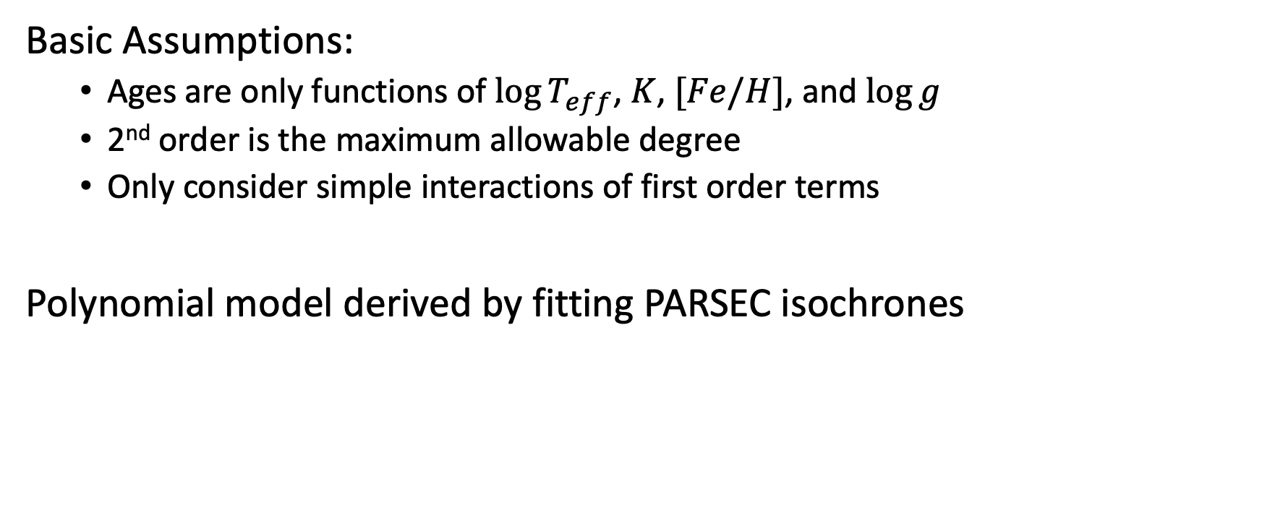
Polynomial Age Interpolation
Basic Assumptions:
Ages are only functions of $\log{T_{eff}}$, $K$, $[Fe/H]$, and $\log{g}$
2nd order is the maximum allowable degree
Only consider simple interactions of first order terms
Polynomial model derived by fitting PARSEC isochrones

Slide 7
Polynomial Age Interpolation
To determine the best fitting polynomial model
Generate a list of all possible models
Fit all models using OLS
Measure goodness of fit using median absolute deviation (MAD) in the residuals
Pick most parsimonious model in lowest MAD bin due to secondary peak in MADs

Slide 8
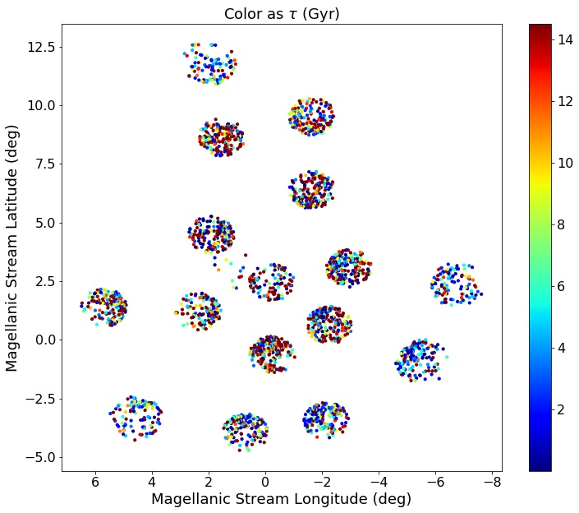
Polynomial Age Interpolation

Slide 9
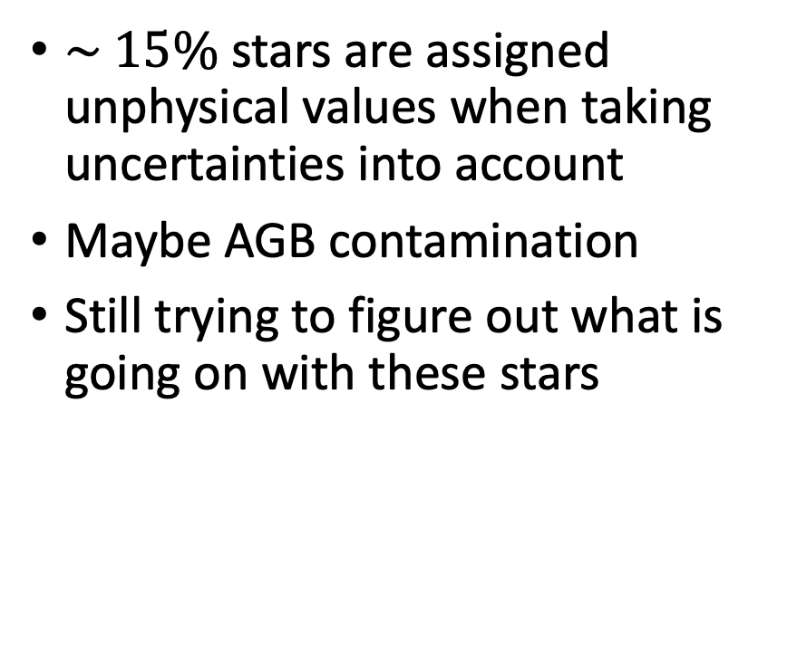
Polynomial Age Interpolation
$\sim 15\%$ stars are assigned unphysical values when taking uncertainties into account
Maybe AGB contamination
Still trying to figure out what is going on with these stars
Notes:
Open to suggestions. Thought may be AGB contamination. Found paper that says higher N, Na, Al and less C, O, Mg -nothing

Slide 10
Polynomial Age Interpolation
Most of the ages calculated are consistent with other methods
Many younger stars are found toward the center of the galaxy
Still trying to figure out the extent of AGB contamination in the RGB sample
When calculating abundance gradients later, age bins were chosen to mitigate the effect of stars that were physically too old

Slide 11
Outline
Star-by-Star Ages of the LMC
Polynomial Age Interpolation
Results
LMC Abundance Gradients
Motivation
Gradient Calculation
Results
Density Profile of the LMC
Motivation
APOGEE Field Mass Calculation
APOGEE Field Area Calculation
Results
Overall Results Recap

Slide 12
LMC Abundance Gradients
Why study LMC gradients to begin with?
Seems logical with all the data APOGEE has taken
Abundance gradients are intrinsically linked with galaxy evolution
Dwarf galaxies are the favored progenitors of larger galaxies thus could provide us a look into the early universe
Further the LMC is actively infalling into the MW, most likely on its first pass and thus can prove enlightening for very early stage galaxy merging (Besla et al. 2010)
Can learn about physical processes in other dwarfs galaxies that are too far away and really faint
Constraint chemical evolution models

Slide 13
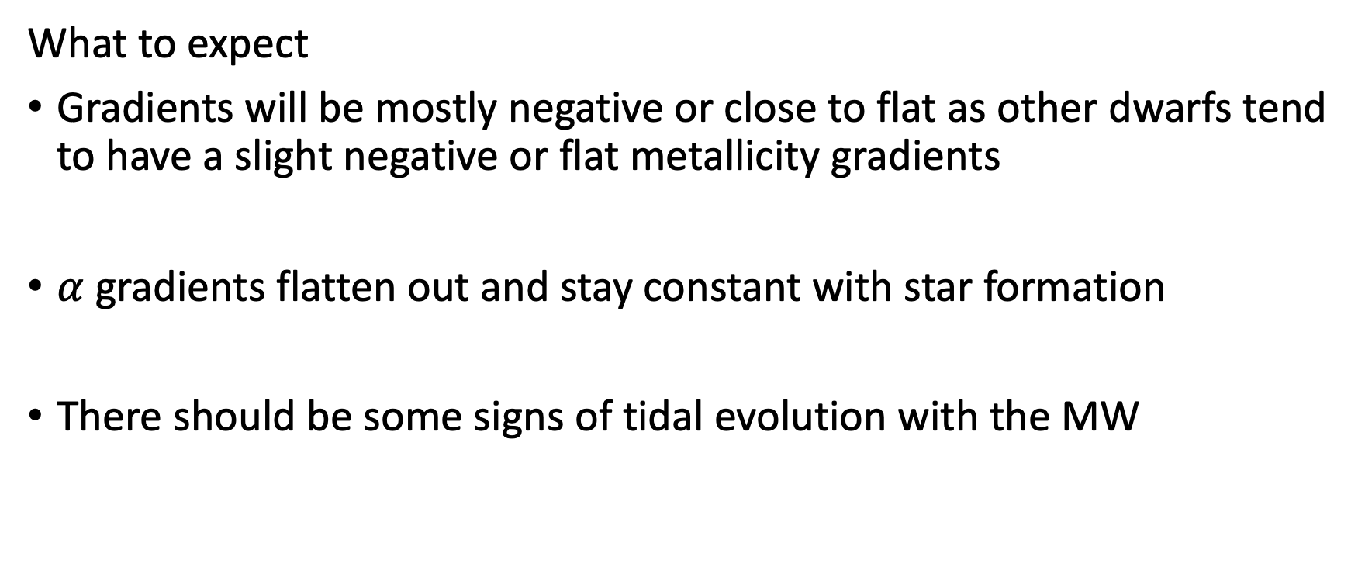
LMC Abundance Gradients
What to expect
Gradients will be mostly negative or close to flat as other dwarfs tend to have a slight negative or flat metallicity gradients
$α$ gradients flatten out and stay constant with star formation
There should be some signs of tidal evolution with the MW

Slide 14
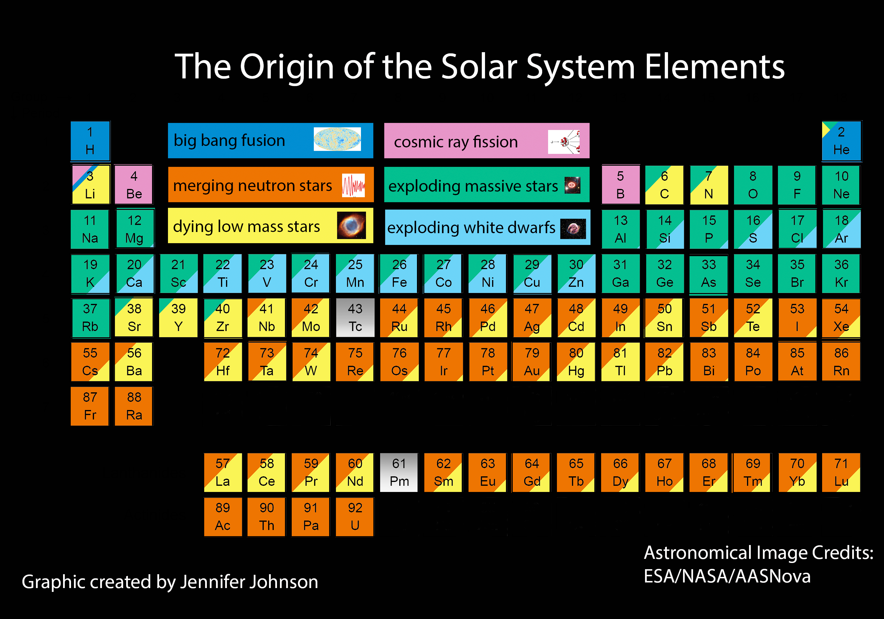
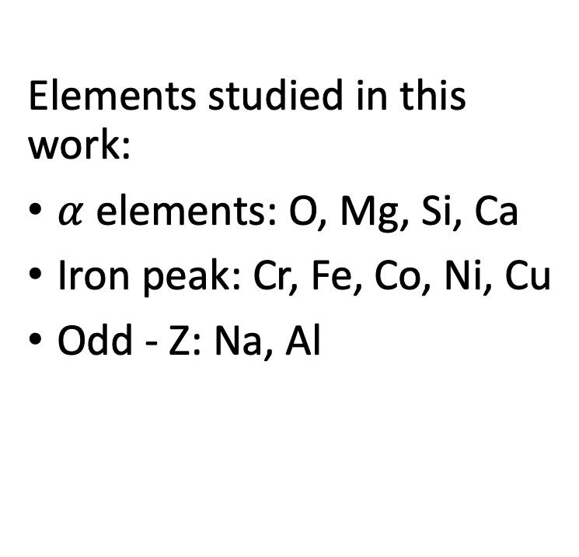
LMC Abundance Gradients
Elements studied in this work:
$α$ elements: O, Mg, Si, Ca
Iron peak: Cr, Fe, Co, Ni, Cu
Odd - Z: Na, Al

Slide 15
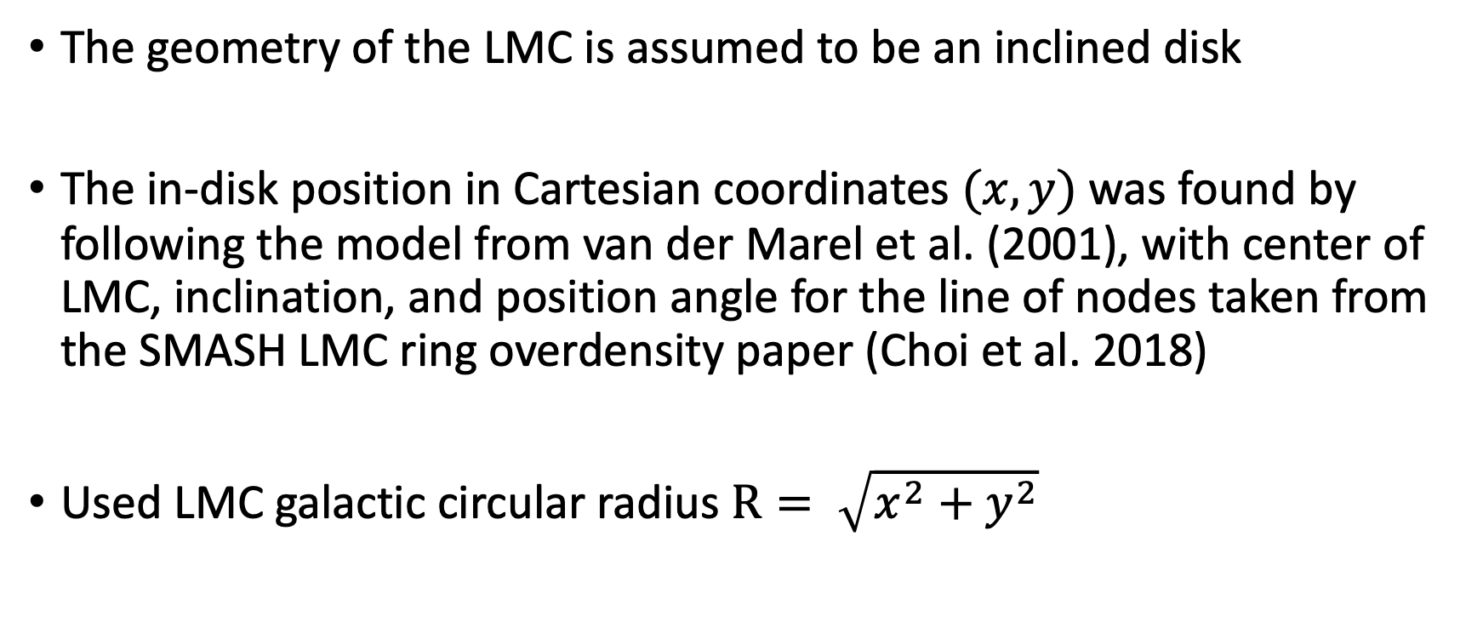
LMC Abundance Gradients
The geometry of the LMC is assumed to be an inclined disk
The in-disk position in Cartesian coordinates $(x,y)$ was found by following the model from van der Marel et al. (2001), with center of LMC, inclination, and position angle for the line of nodes taken from the SMASH LMC ring overdensity paper (Choi et al. 2018)
Used LMC galactic circular radius $R= \sqrt{x^{2}+y^{2}}$

Slide 16
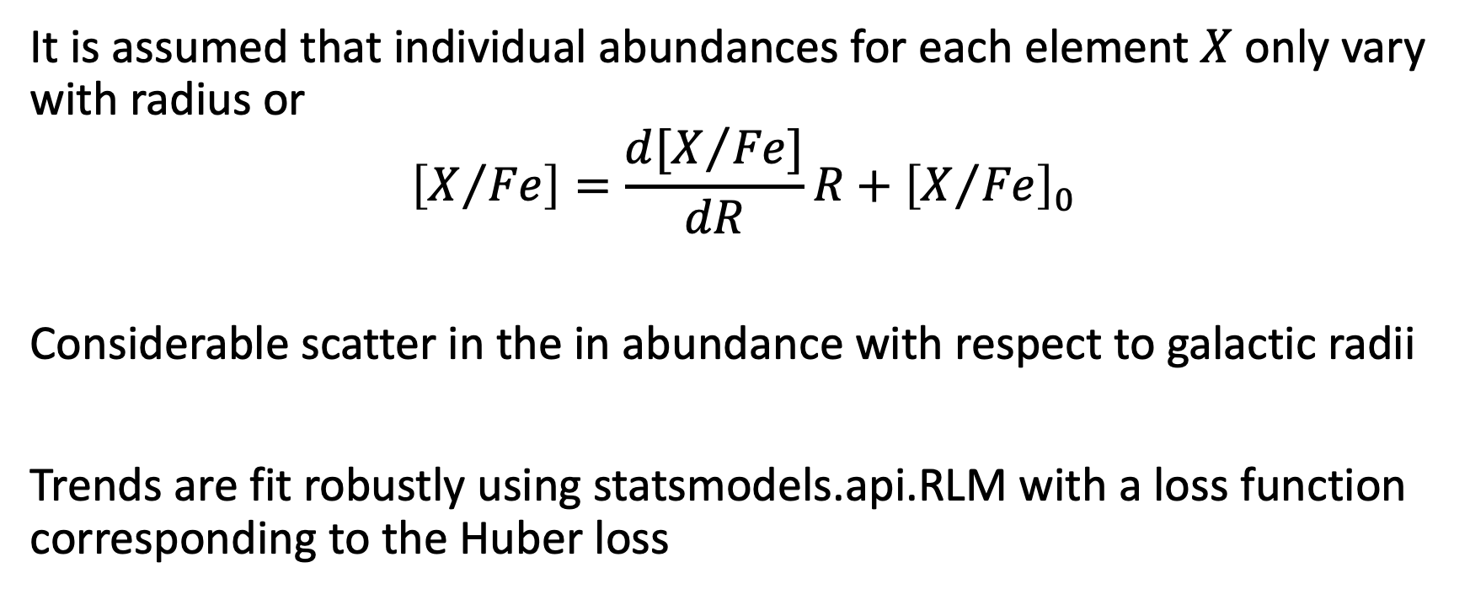
LMC Abundance Gradients
It is assumed that individual abundances for each element $X$ only vary with radius or
$$\left[X/{Fe}\right]=\frac{d[X/{Fe}]}{dR}R+{\left[X/{Fe}\right]}_{0}$$
Considerable scatter in the in abundance with respect to galactic radii
Trends are fit robustly using statsmodels.api.RLM with a loss function corresponding to the Huber loss

Slide 17
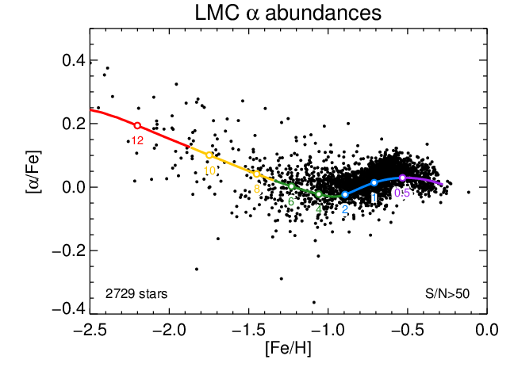
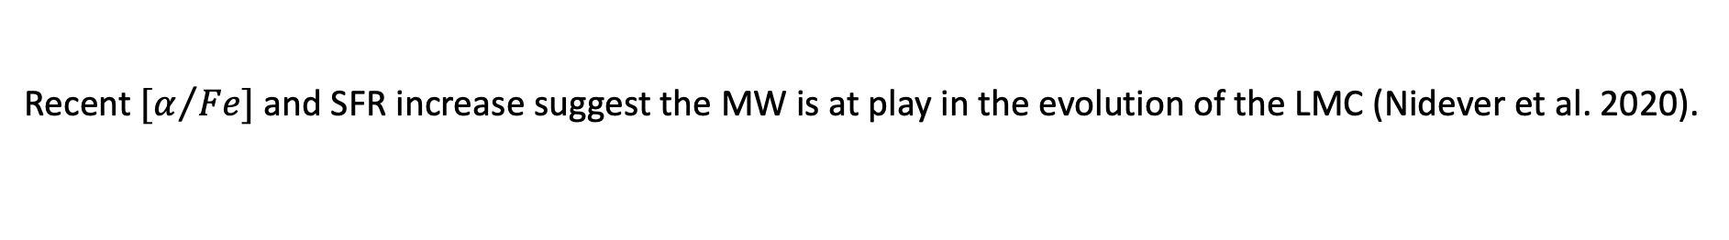
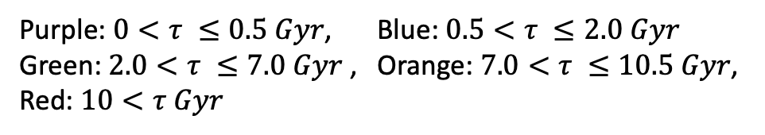
LMC Abundance Gradients
Purple: $0<τ ≤0.5 Gyr$, Blue: $0.5<τ ≤2.0 Gyr$
Green: $2.0<τ ≤7.0 Gyr$, Orange: $7.0<τ ≤10.5 Gyr$,
Red: $10<τ Gyr$
Image Credit: Nidever et al. 2020
Recent $[α/{Fe}]$ and SFR increase suggest the MW is at play in the evolution of the LMC (Nidever et al. 2020).

Slide 18
Iron
The iron trends follow a nice spectrum in age
All gradients for the different bins are negative as expected
Younger stars have an overall steeper gradient so younger more iron rich stars found in the center of the galaxy

Slide 19
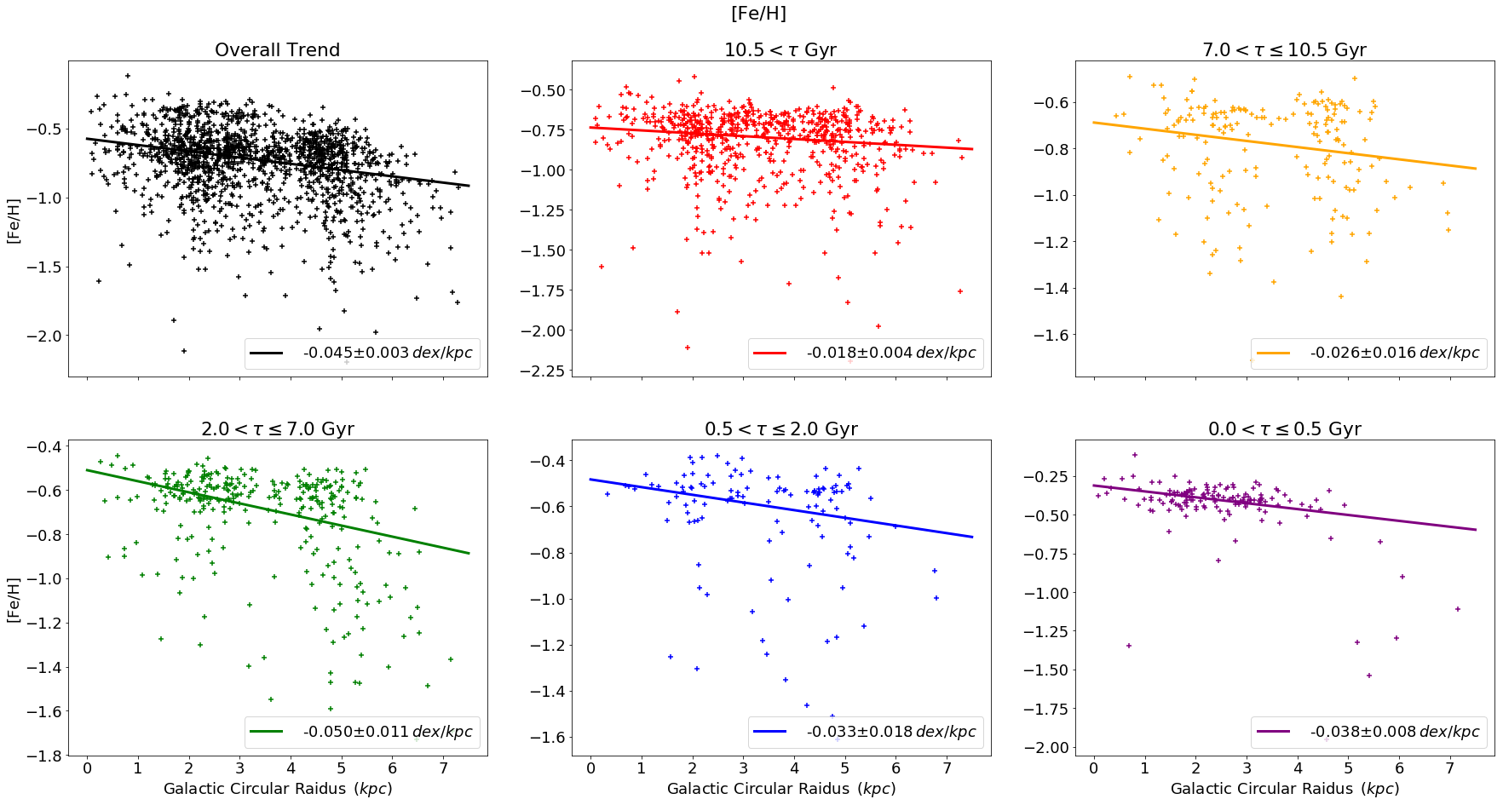
Significant scatter can be seen in the data for all elements

Slide 20
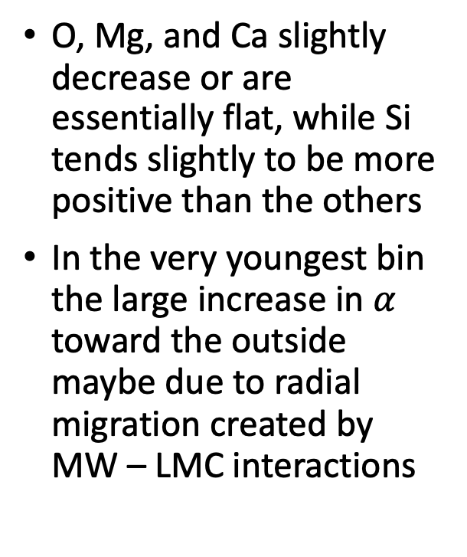

$α$ Elements
O, Mg, and Ca slightly decrease or are essentially flat, while Si tends slightly to be more positive than the others
In the very youngest bin the large increase in $α$ toward the outside maybe due to radial migration created by MW – LMC interactions

Slide 21
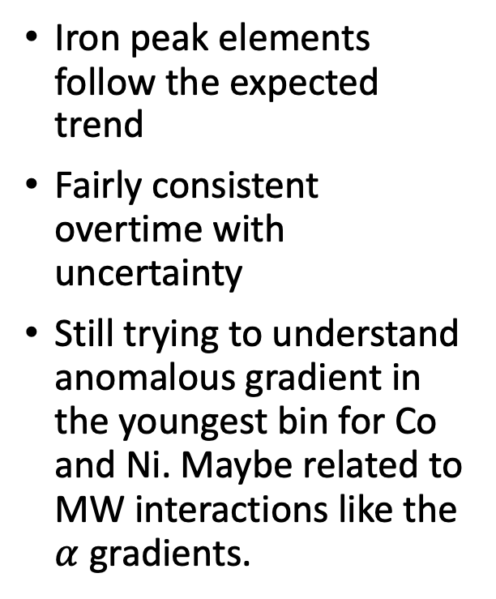
Iron Peak
Iron peak elements follow the expected trend
Fairly consistent overtime with uncertainty
Still trying to understand anomalous gradient in the youngest bin for Co and Ni. Maybe related to MW interactions like the $α$ gradients.

Slide 22
LMC Abundance Gradients

Slide 23
LMC Abundance Gradients
The relative flatness in the MW compared to the LMC is to be expected as the MW
has experienced radial migration

Slide 24
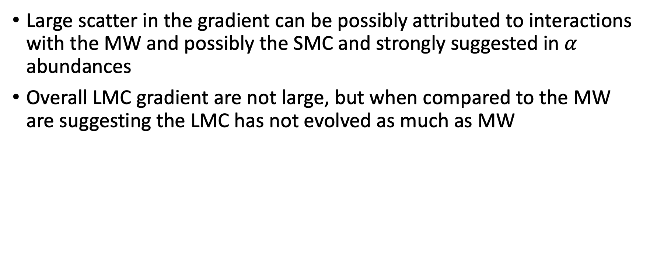
LMC Abundance Gradients
Large scatter in the gradient can be possibly attributed to interactions with the MW and possibly the SMC and strongly suggested in $α$ abundances
Overall LMC gradient are not large, but when compared to the MW are suggesting the LMC has not evolved as much as MW

Slide 25
Outline
Star-by-Star Ages of the LMC
Polynomial Age Interpolation
Results
LMC Abundance Gradients
Motivation
Gradient Calculation
Results
Density Profile of the LMC
Motivation
APOGEE Field Mass Calculation
APOGEE Field Area Calculation
Results
Overall Results Recap

Slide 26
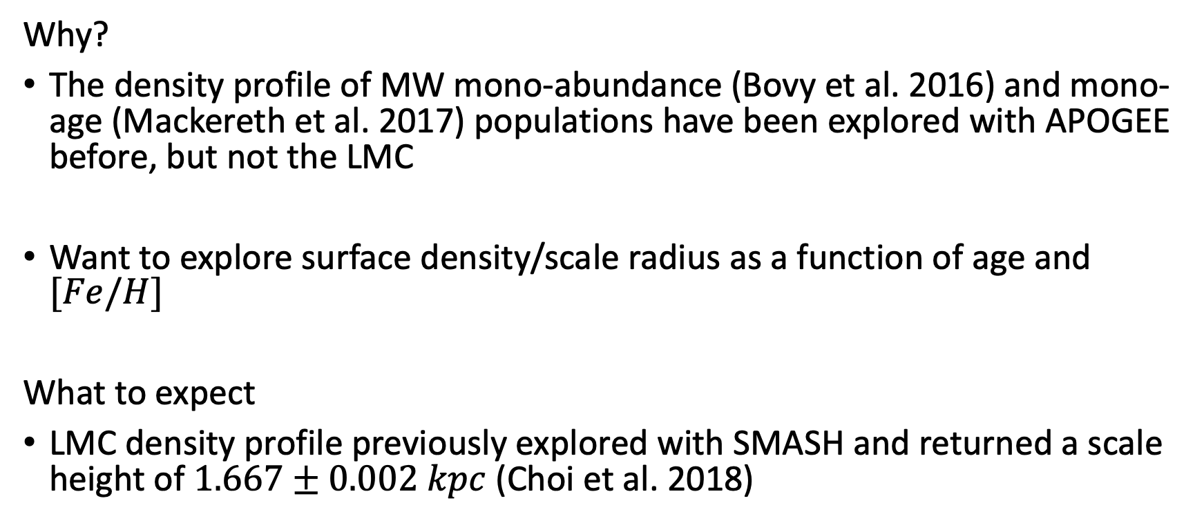
Density Profile of the LMC
Why?
The density profile of MW mono-abundance (Bovy et al. 2016) and mono-age (Mackereth et al. 2017) populations have been explored with APOGEE before, but not the LMC
Want to explore surface density/scale radius as a function of age and $[Fe/H]$
What to expect
LMC density profile previously explored with SMASH and returned a scale height of $1.667±0.002 kpc$ (Choi et al. 2018)

Slide 27
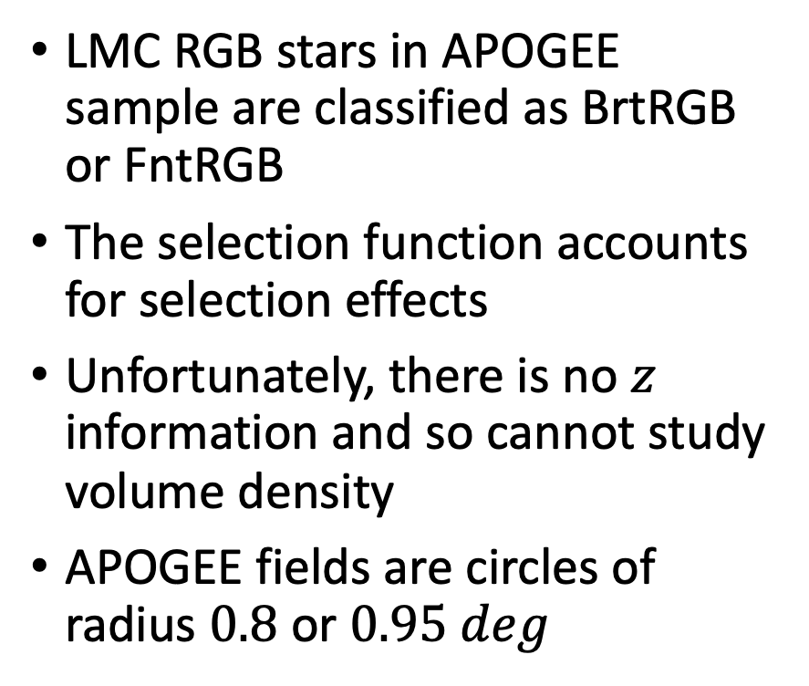
Density Profile of the LMC
LMC RGB stars in APOGEE sample are classified as BrtRGB or FntRGB
The selection function accounts for selection effects
Unfortunately, there is no $z$ information and so cannot study volume density
APOGEE fields are circles of radius $0.8$ or $0.95 deg$

Slide 28
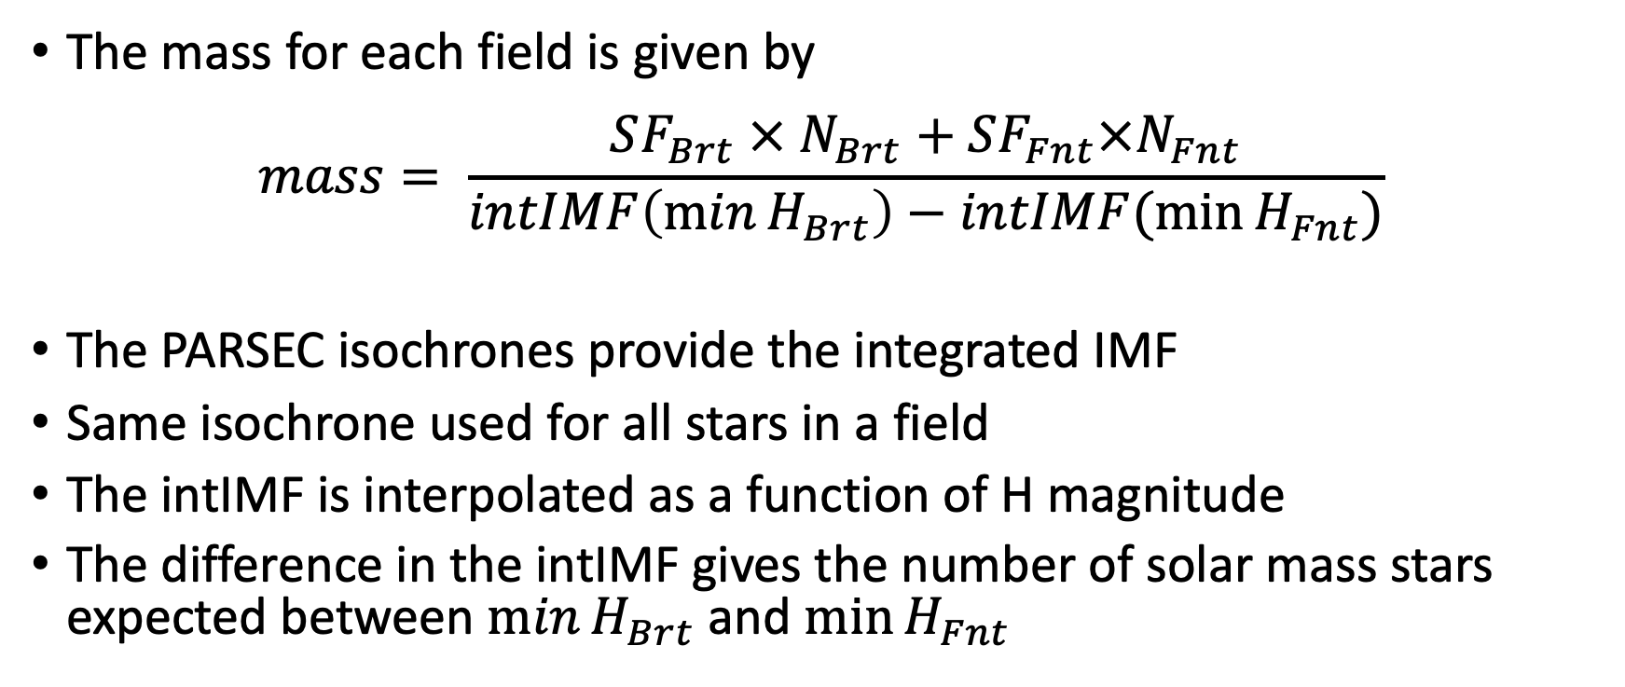
Density Profile of the LMC
The mass for each field is given by
$$mass= \frac{SF_{Brt} × N_{Brt}+SF_{Fnt}×N_{Fnt}}{intIMF\left(\min{H_{Brt}}\right)−intIMF(\min{H_{Fnt}})}$$
The PARSEC isochrones provide the integrated IMF
Same isochrone used for all stars in a field
The intIMF is interpolated as a function of H magnitude
The difference in the intIMF gives the number of solar mass stars expected between $\min{H_{Brt}}$ and $\min{H_{Fnt}}$

Slide 29
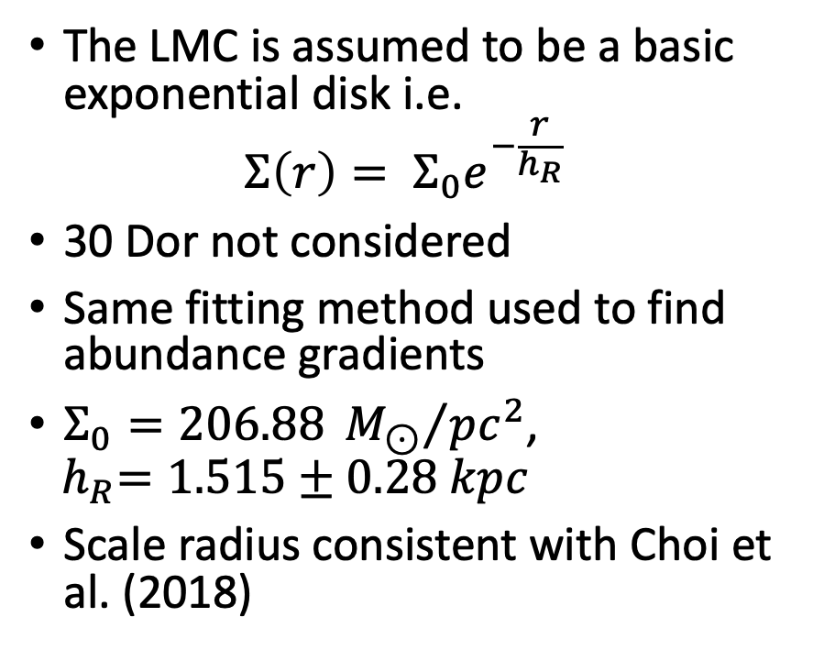
Density Profile of the LMC
The LMC is assumed to be a basic exponential disk i.e.
$${Σ\left(r\right)= Σ}_{0}e^{−\frac{r}{h_{R}}}$$
30 Dor not considered
Same fitting method used to find abundance gradients
$Σ_{0}=206.88 {M_{⊙}}/{pc^{2}}$,
$${ h}_{R}=1.515±0.28 kpc$$
Scale radius consistent with Choi et al. (2018)

Slide 30
Outline
Star-by-Star Ages of the LMC
Polynomial Age Interpolation
Results
LMC Abundance Gradients
Motivation
Gradient Calculation
Results
Density Profile of the LMC
Motivation
APOGEE Field Mass Calculation
APOGEE Field Area Calculation
Results
Overall Results Recap

Slide 31
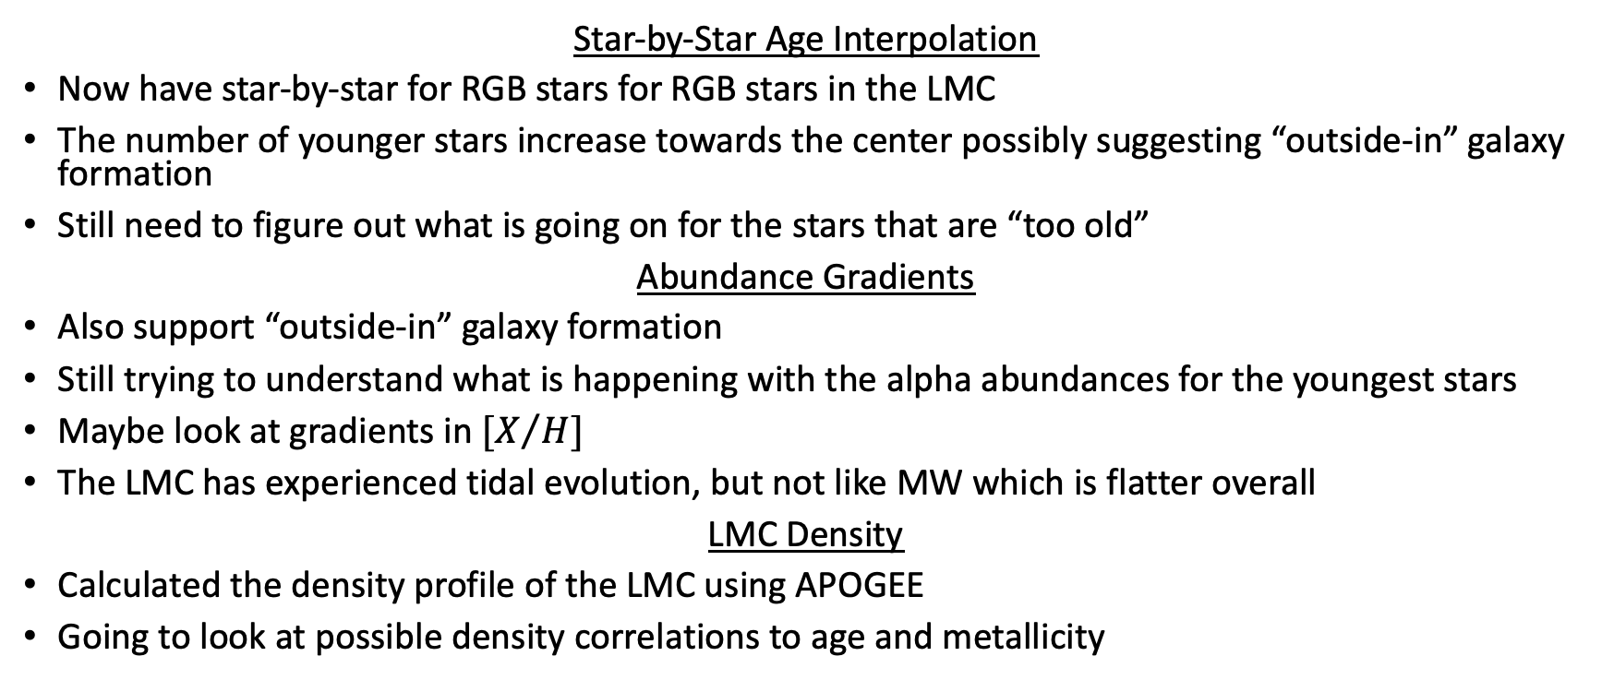
Overall Results Recap
Star-by-Star Age Interpolation
Now have star-by-star for RGB stars for RGB stars in the LMC
The number of younger stars increase towards the center possibly suggesting “outside-in” galaxy formation
Still need to figure out what is going on for the stars that are “too old”
Abundance Gradients
Also support “outside-in” galaxy formation
Still trying to understand what is happening with the alpha abundances for the youngest stars
Maybe look at gradients in $[X/H]$
The LMC has experienced tidal evolution, but not like MW which is flatter overall
LMC Density
Calculated the density profile of the LMC using APOGEE
Going to look at possible density correlations to age and metallicity

Slide 32




Acknowledgements
David Nidever, Sten Hasselquist,
Diane Feuillet, Yumi Choi, Christian Hayes

Slide 33
